Slide 1

BDL Vessel Cleaner Final Testing Results
Steven Schwartz, Milo Gubler, Mason Minitti, Muath Nasrallah

Slide 2
Testing Plan
Table 1 – Test Summary Table
Experiment/ Test | Description | DR Summary
Ex1 | Filter Capacity | CR8/ER5 – Multiple Cycles before Filter Replacement, Filter holds equivalent of ~10 cleaning cycles CR7/ER13 – Uses a Mesh to collect Support Material, Mesh needs to be <1000 microns
Ex2 | Model Failure Pressure | CR15/ER10 - Working Pressure Gauge has 1 mmHg Resolution CR16/ER17 - Unruptured Models, Maximum Water Pressure
Ex3 | Model Deflection | CR2, ER1 – Provides <50 C Water to the model using a Water Heater CR15, ER11 – Temperature Measurement w/ at least 1 C Resolution
Ex4 | Minimum Sodium Hydroxide Pretreatment Time | CR16/ER 9/CR5 – Clean Models within 24 hours of print
Ex5 | Minimum Model Cleaning Time | CR1/ER3 - Uses a Pump that Provides Pressure from 120-200 mmHg CR2/ER1 – Provides Temperature to Support Material w/out CR17/ER1/ER 17 – Provides Pressure to break up Support Material w/out rupturing model CR16/ER 9/CR5 – Clean Models within 24 hours of print

Slide 3
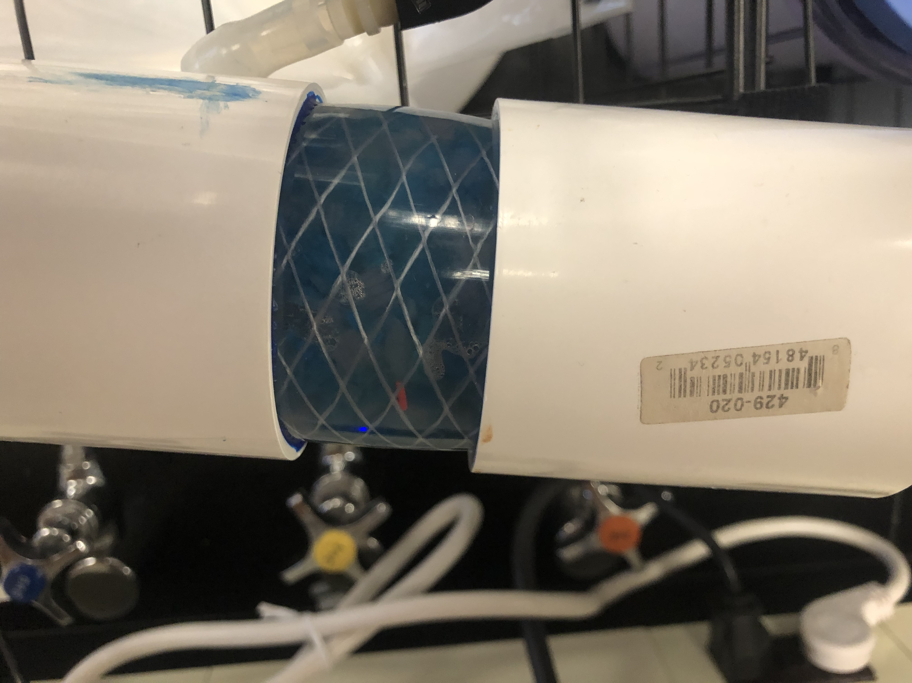
Filter Testing
Filter 1 Capacity is needed to determine the number of cycles before emptying it.
Added ~130 g of Support Material (SM)
  Circle of Willis (CW) without aneurysms is ~11 grams of SM
  Equivalent of 12 CW cleaning cycles
Ran Heat Bath/Peristaltic Pump
  1-10 mmHg Spike in Pressure
Maximum Capacity is 130 g
  Filter can run a minimum of 12 cleaning cycles assuming no SM is dissolved
Figure 1. Filter with 130 g of SM

Slide 4
Vessel Failures
Pressure Failure is needed to determine Arduino buzzer alarm
Vessels commonly failed when:
  Subjected to several cycles at 250 mmHg
  Exterior Manifold was sealed – causing pressure buildup – failure above 400 mmHg
Pressure needed for Arduino buzzer alarm is 240 mmHg

Slide 5
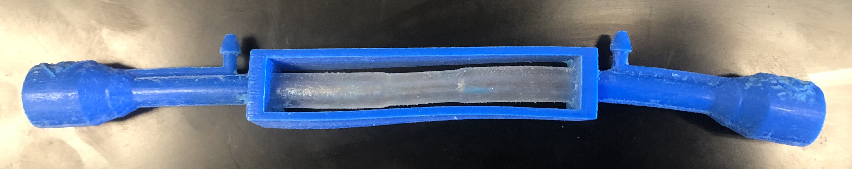
Model Deflection
Deflection is the bending/deformation on the vessel frame caused by heat/torque
Vero Material Deflection temperature: 45 – 50 C
Deflection minimized after adding manifold and reducing tubing – Less torque applied to the barbs/connectors
Ideal Temperature: 48 – 49 C
Figure 2. Deformed Model from 50+ C

Slide 6
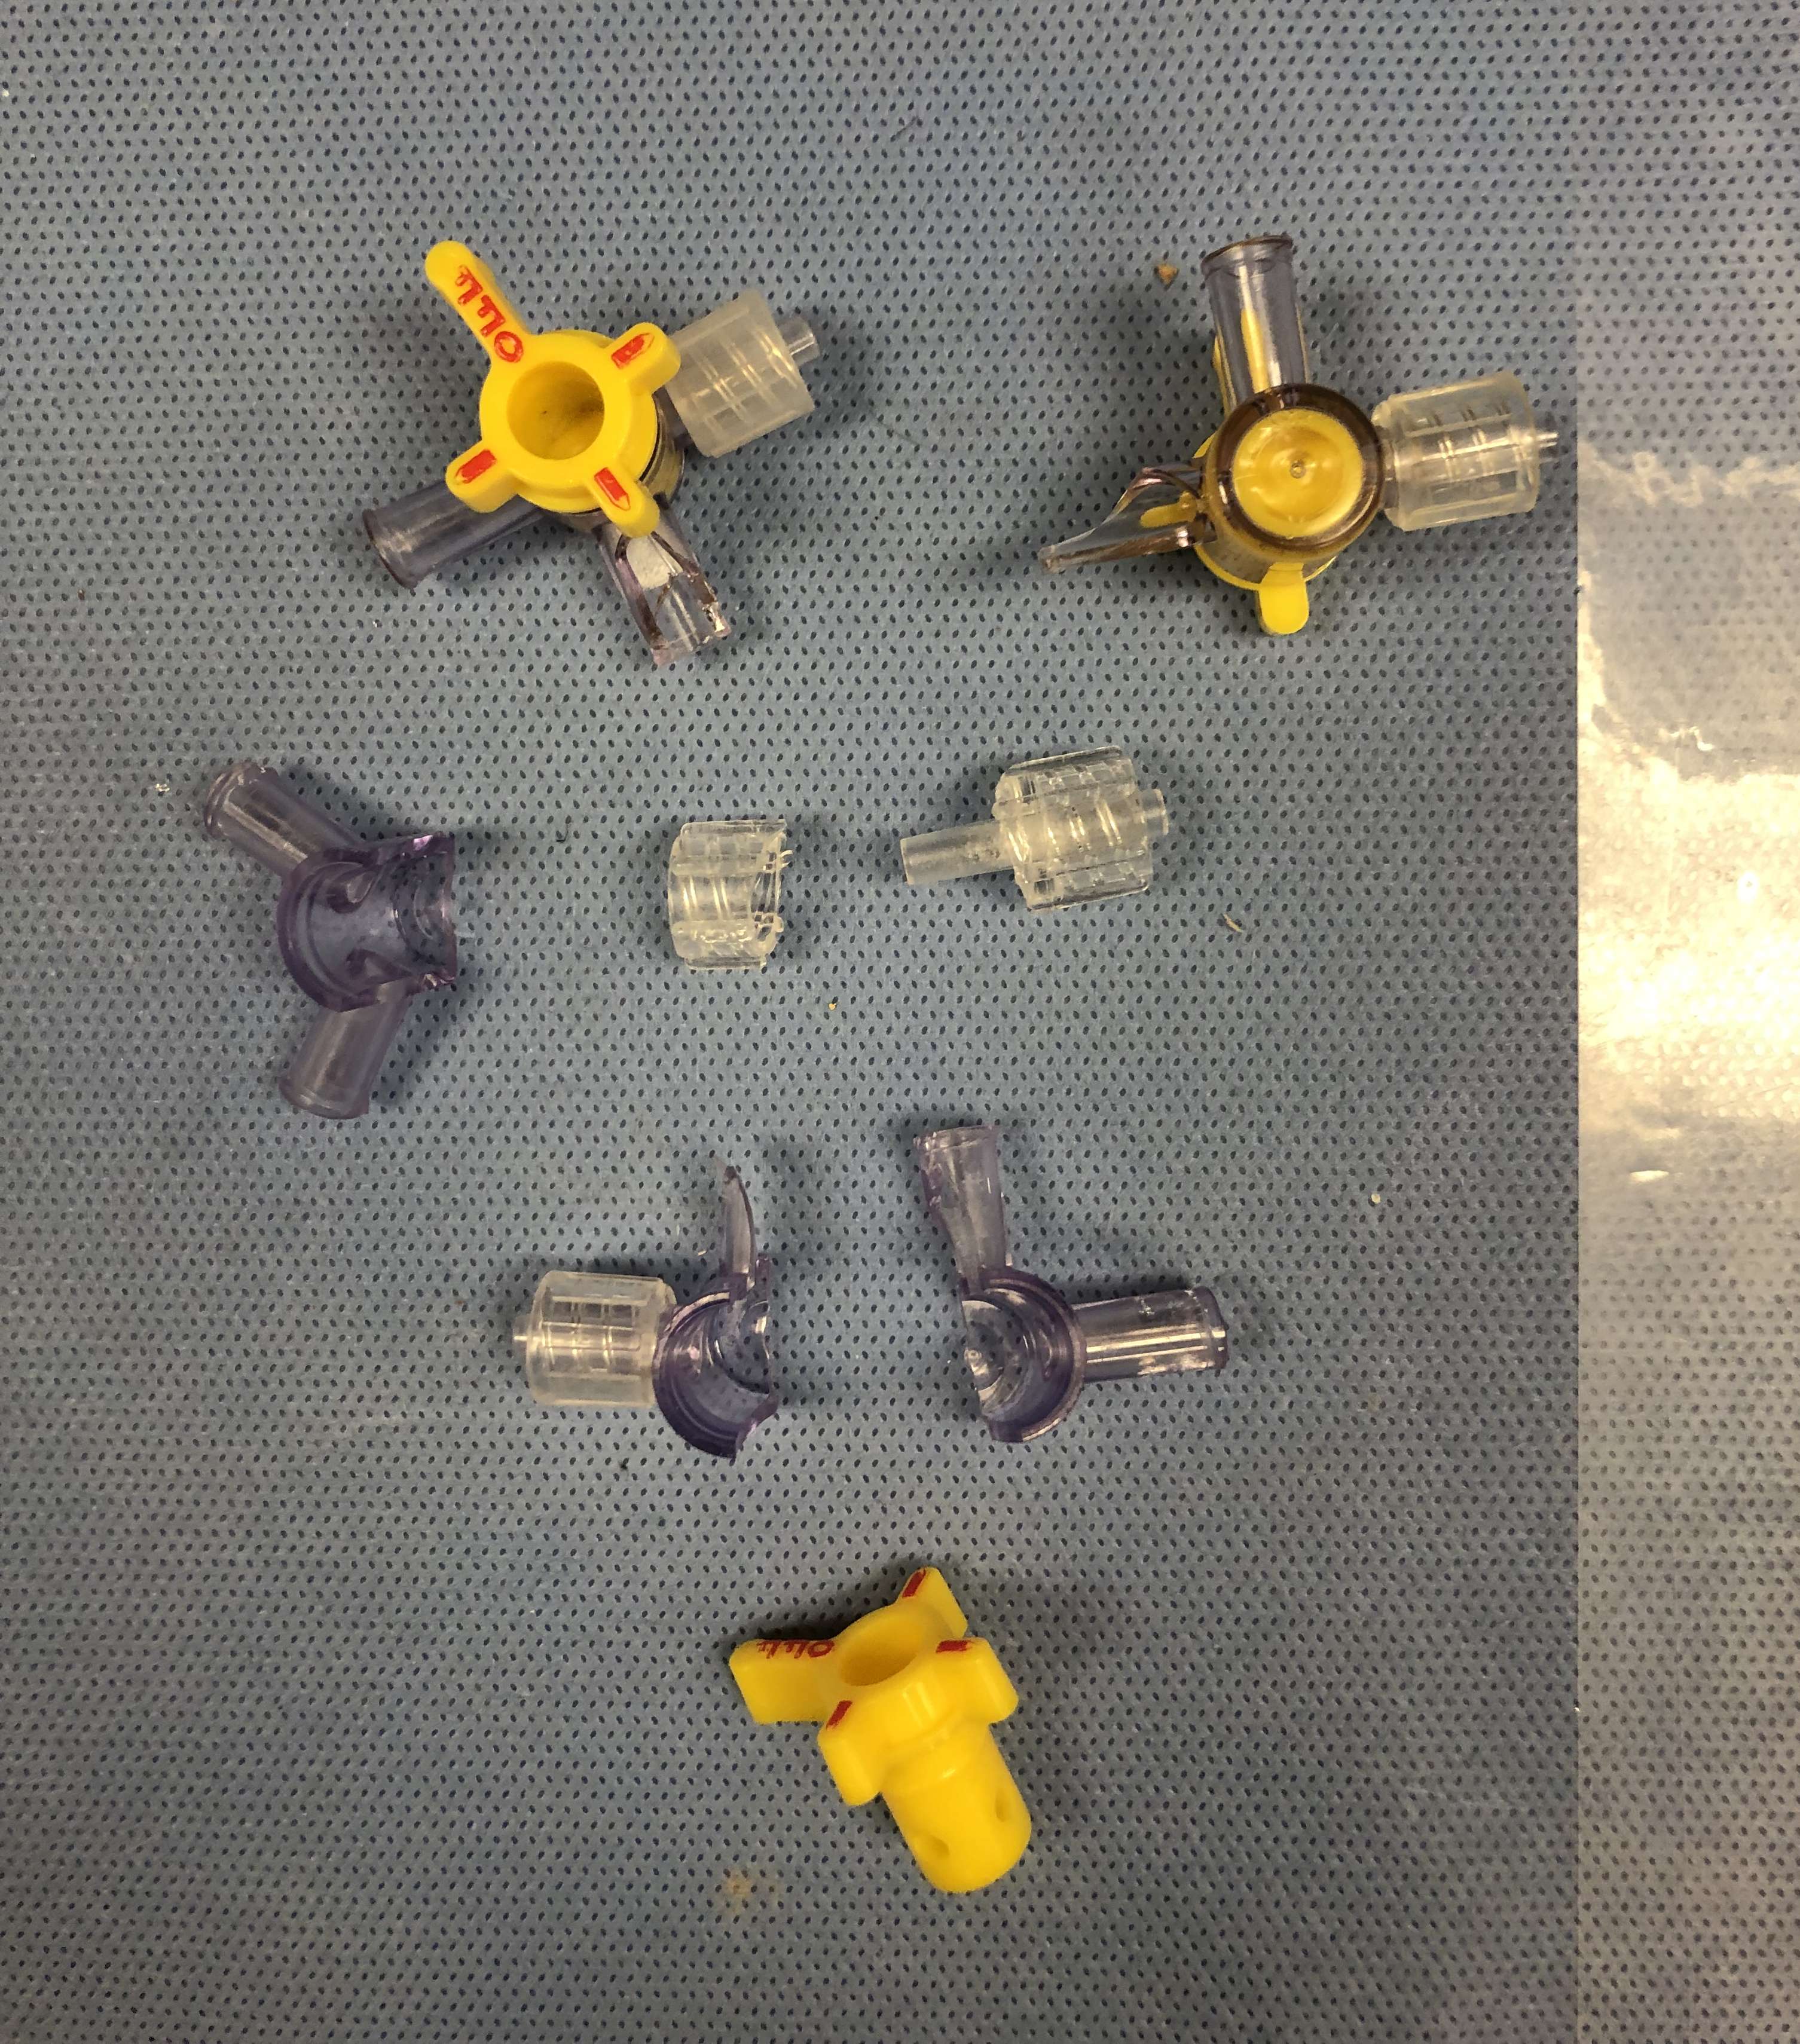
Sodium Hydroxide Pretreatment
Sodium Hydroxide (NaOH) is required to chemically degrade support material
10 minutes of exposure to NaOH is enough to degrade SM, but the main challenge is exposing enough layers
NaOH CANNOT be introduced into the fluid supply
  Causes wear to the manifold material (Polycarbonate)*
  Polystat Heat Bath manual advises against high pH changes for long-term performance*
  *Potential Future Design Aspect for Final Report
Figure 3. Fractured Manifold Stopcocks after NaOH exposure

Slide 7
Model Cleaning Time
Sidewalls clean in 2-4 hours* - Lite SM
CW models clean in 6-8 hours* - Lite SM
DAR models cleans in 2-4 hours* - Standard SM
*Estimated Time based on sections of models that have been cleaned during the testing process and sections of models that have been pretreated with NaOH

Slide 8
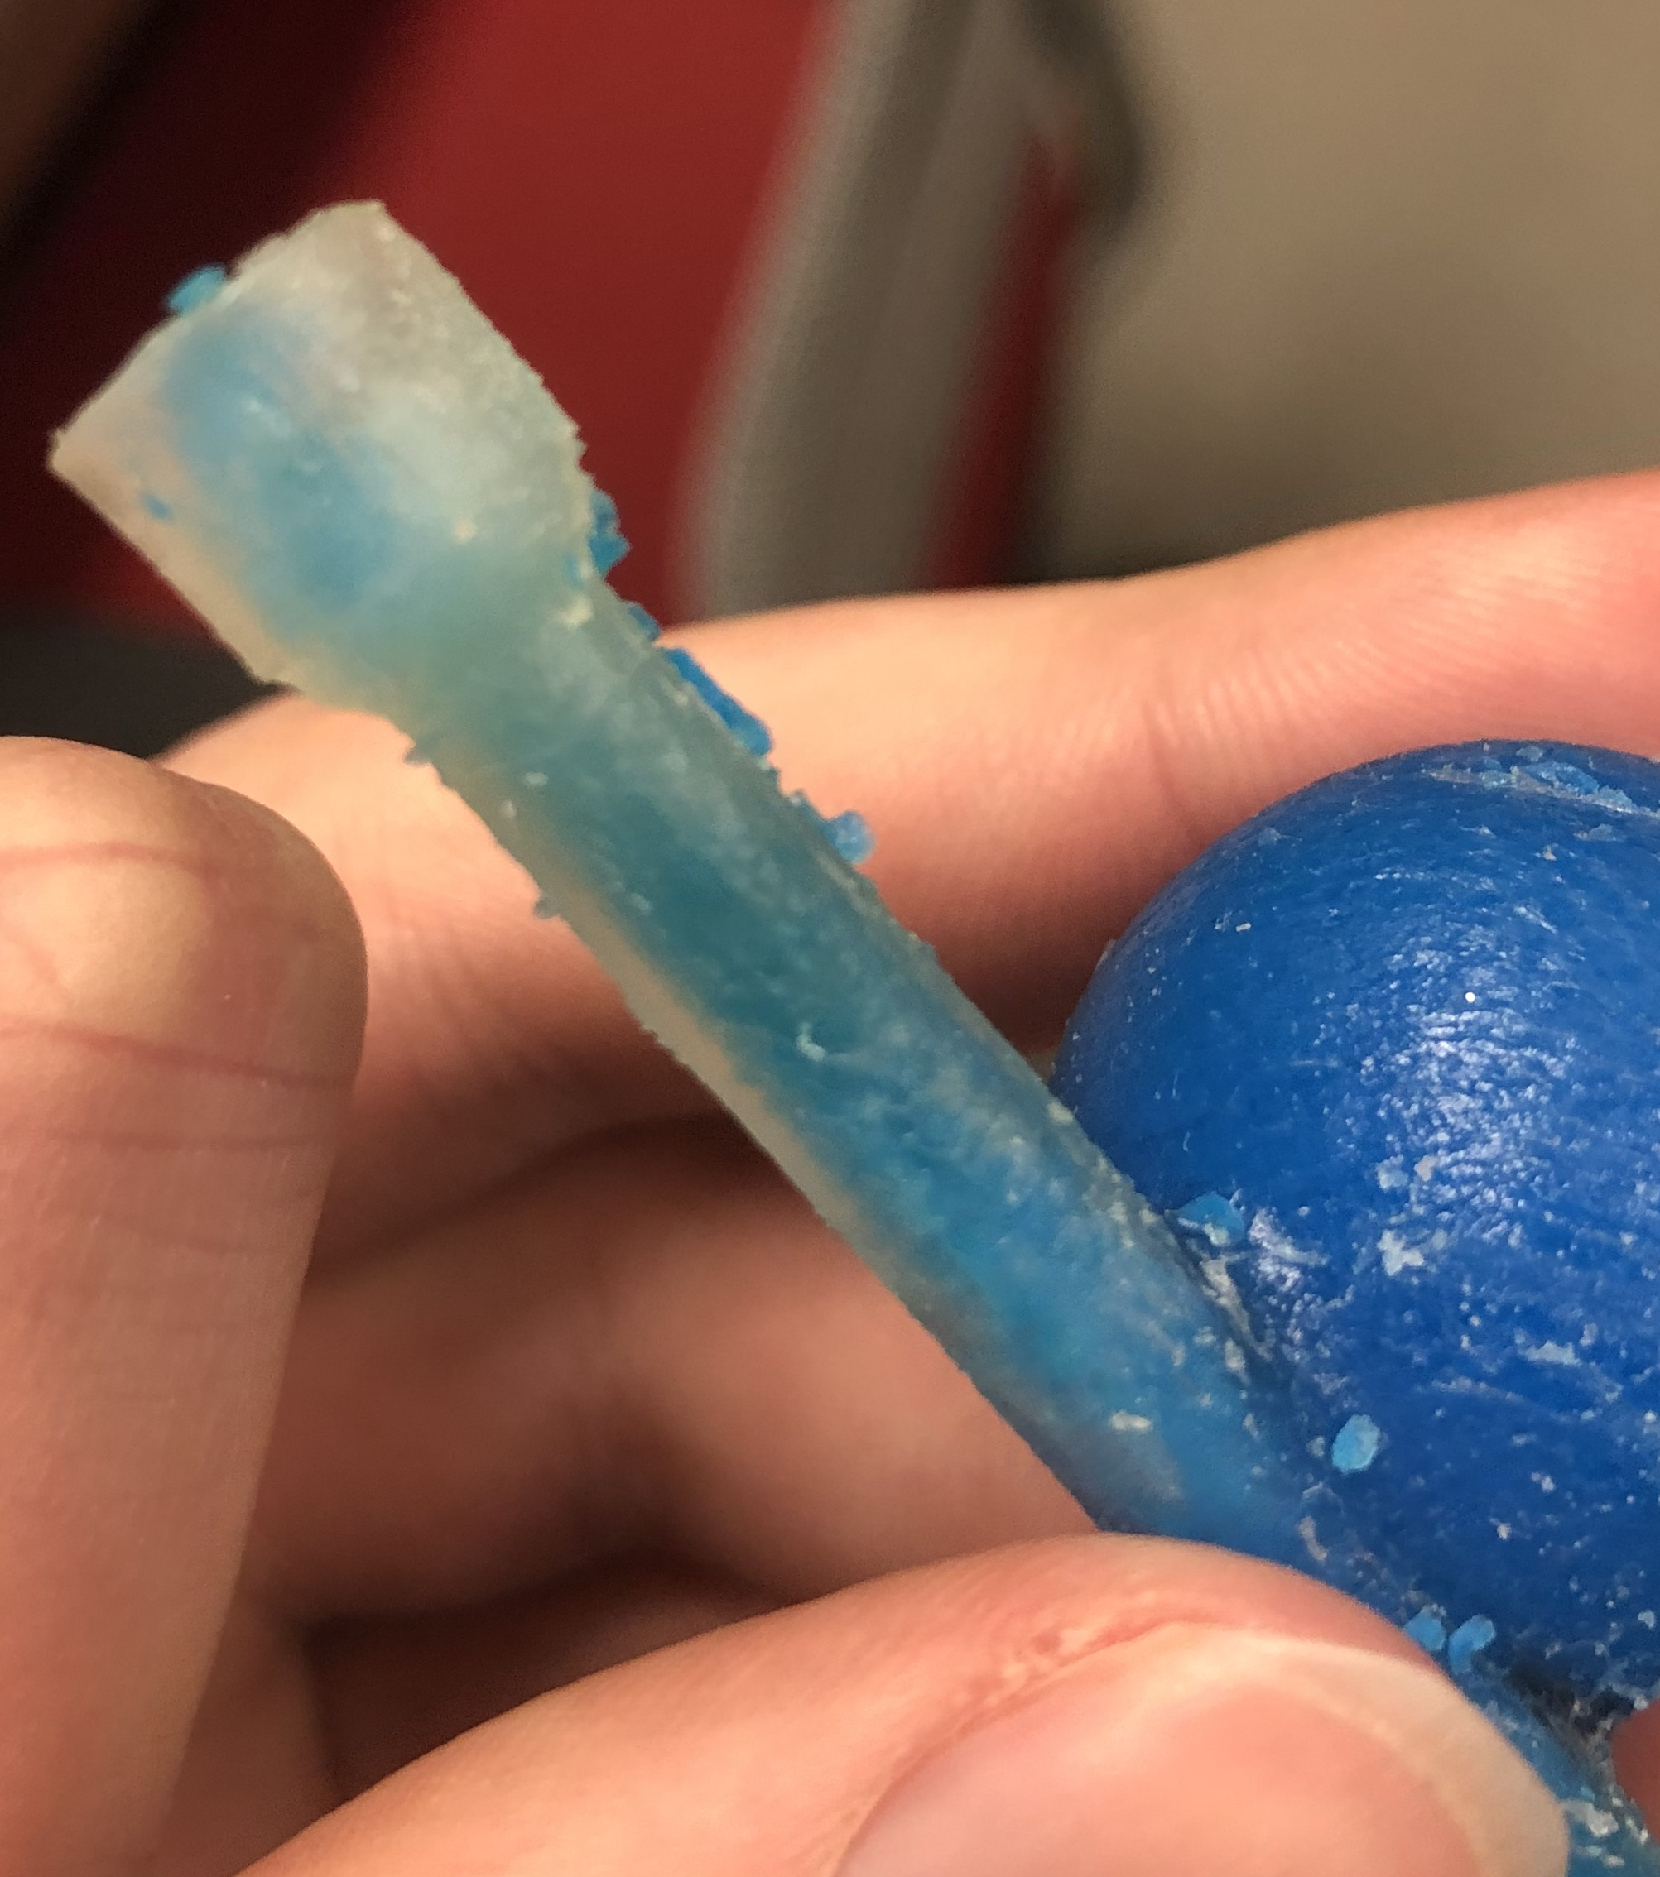
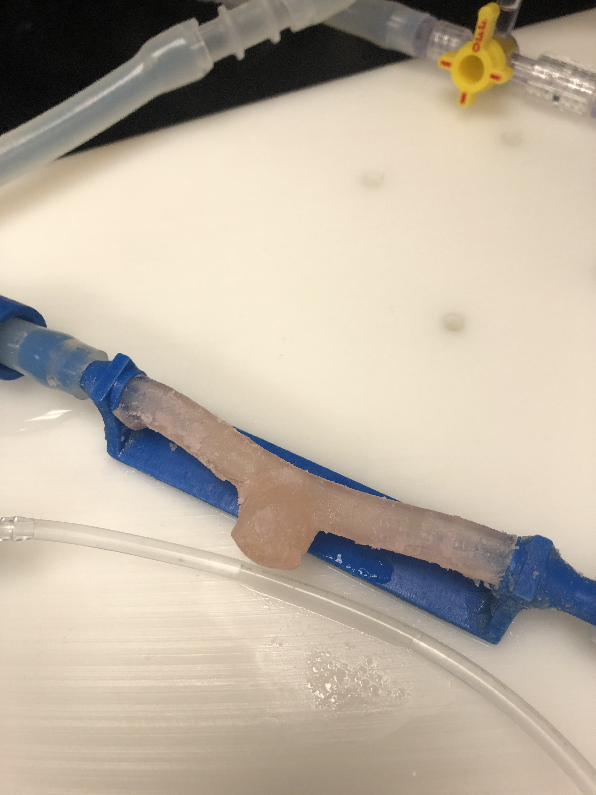
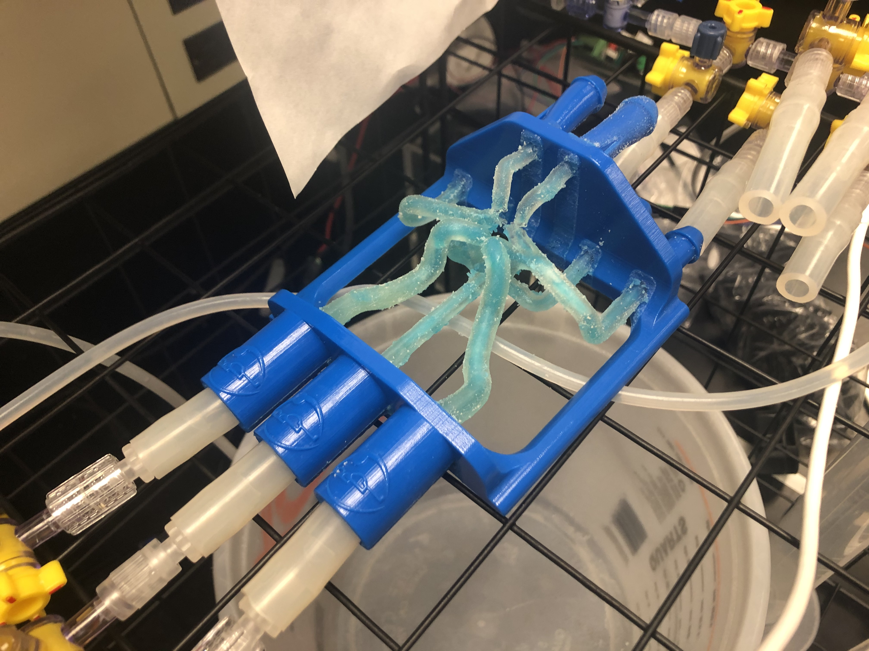
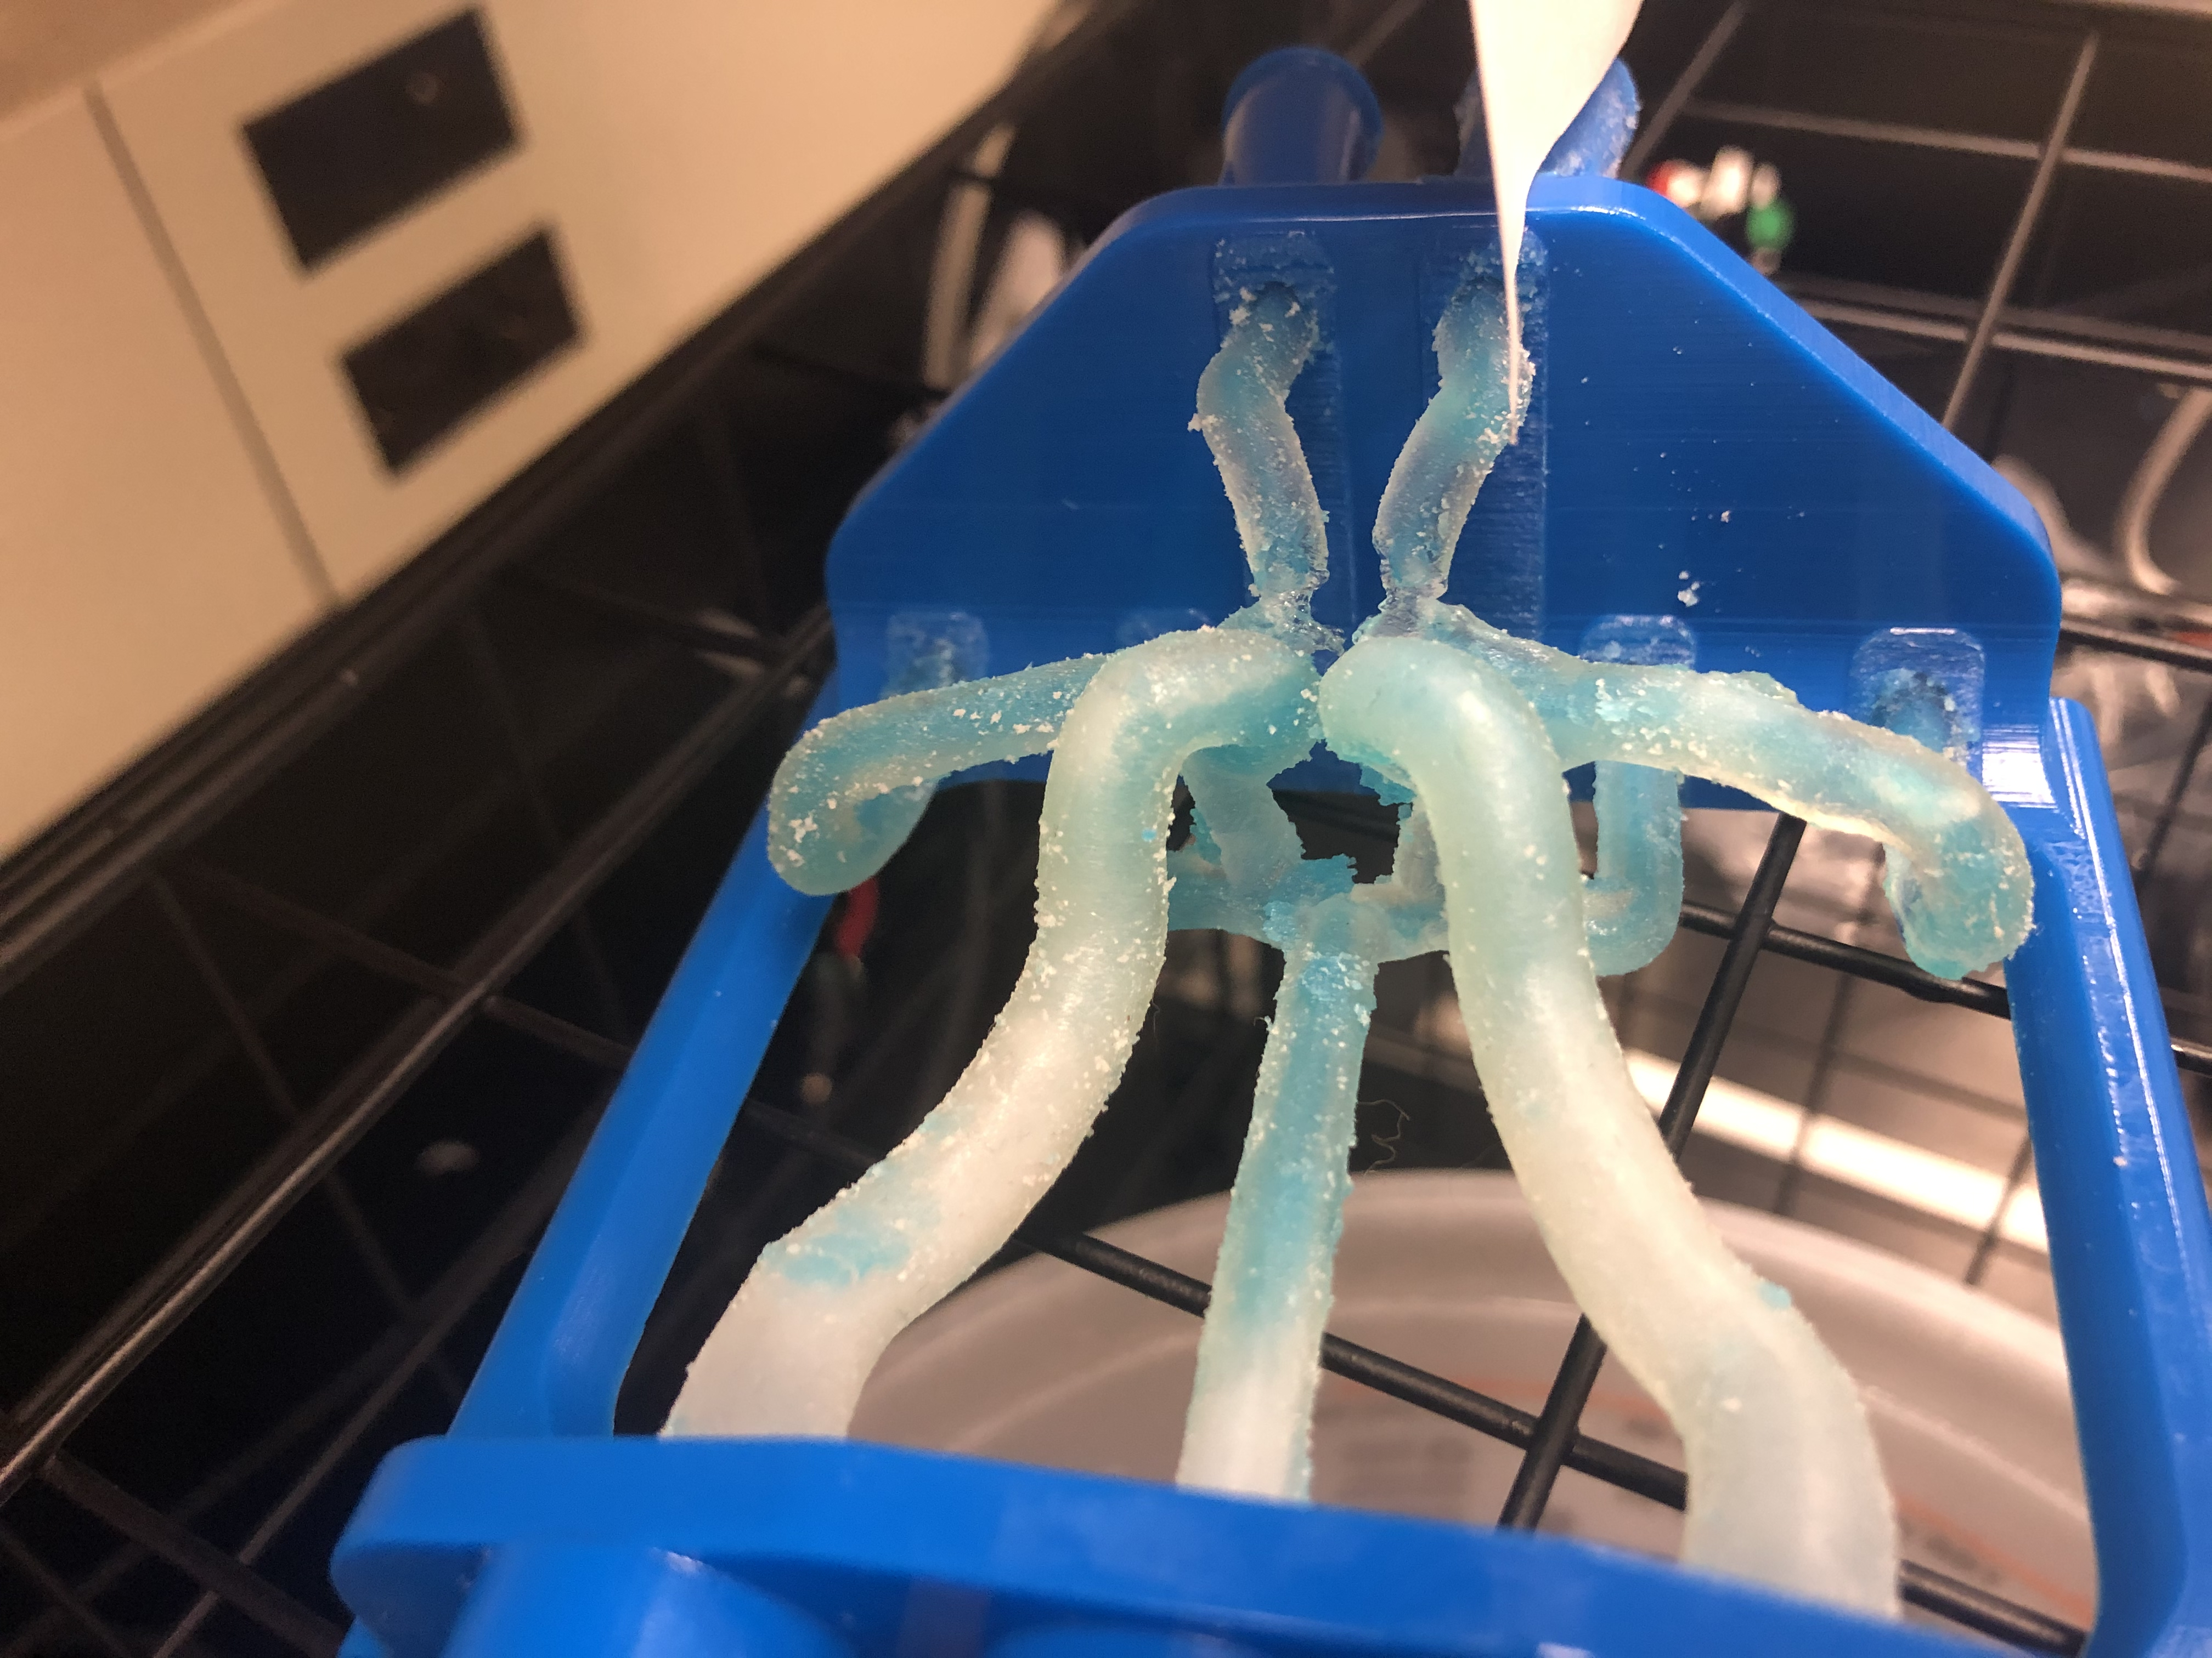
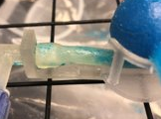
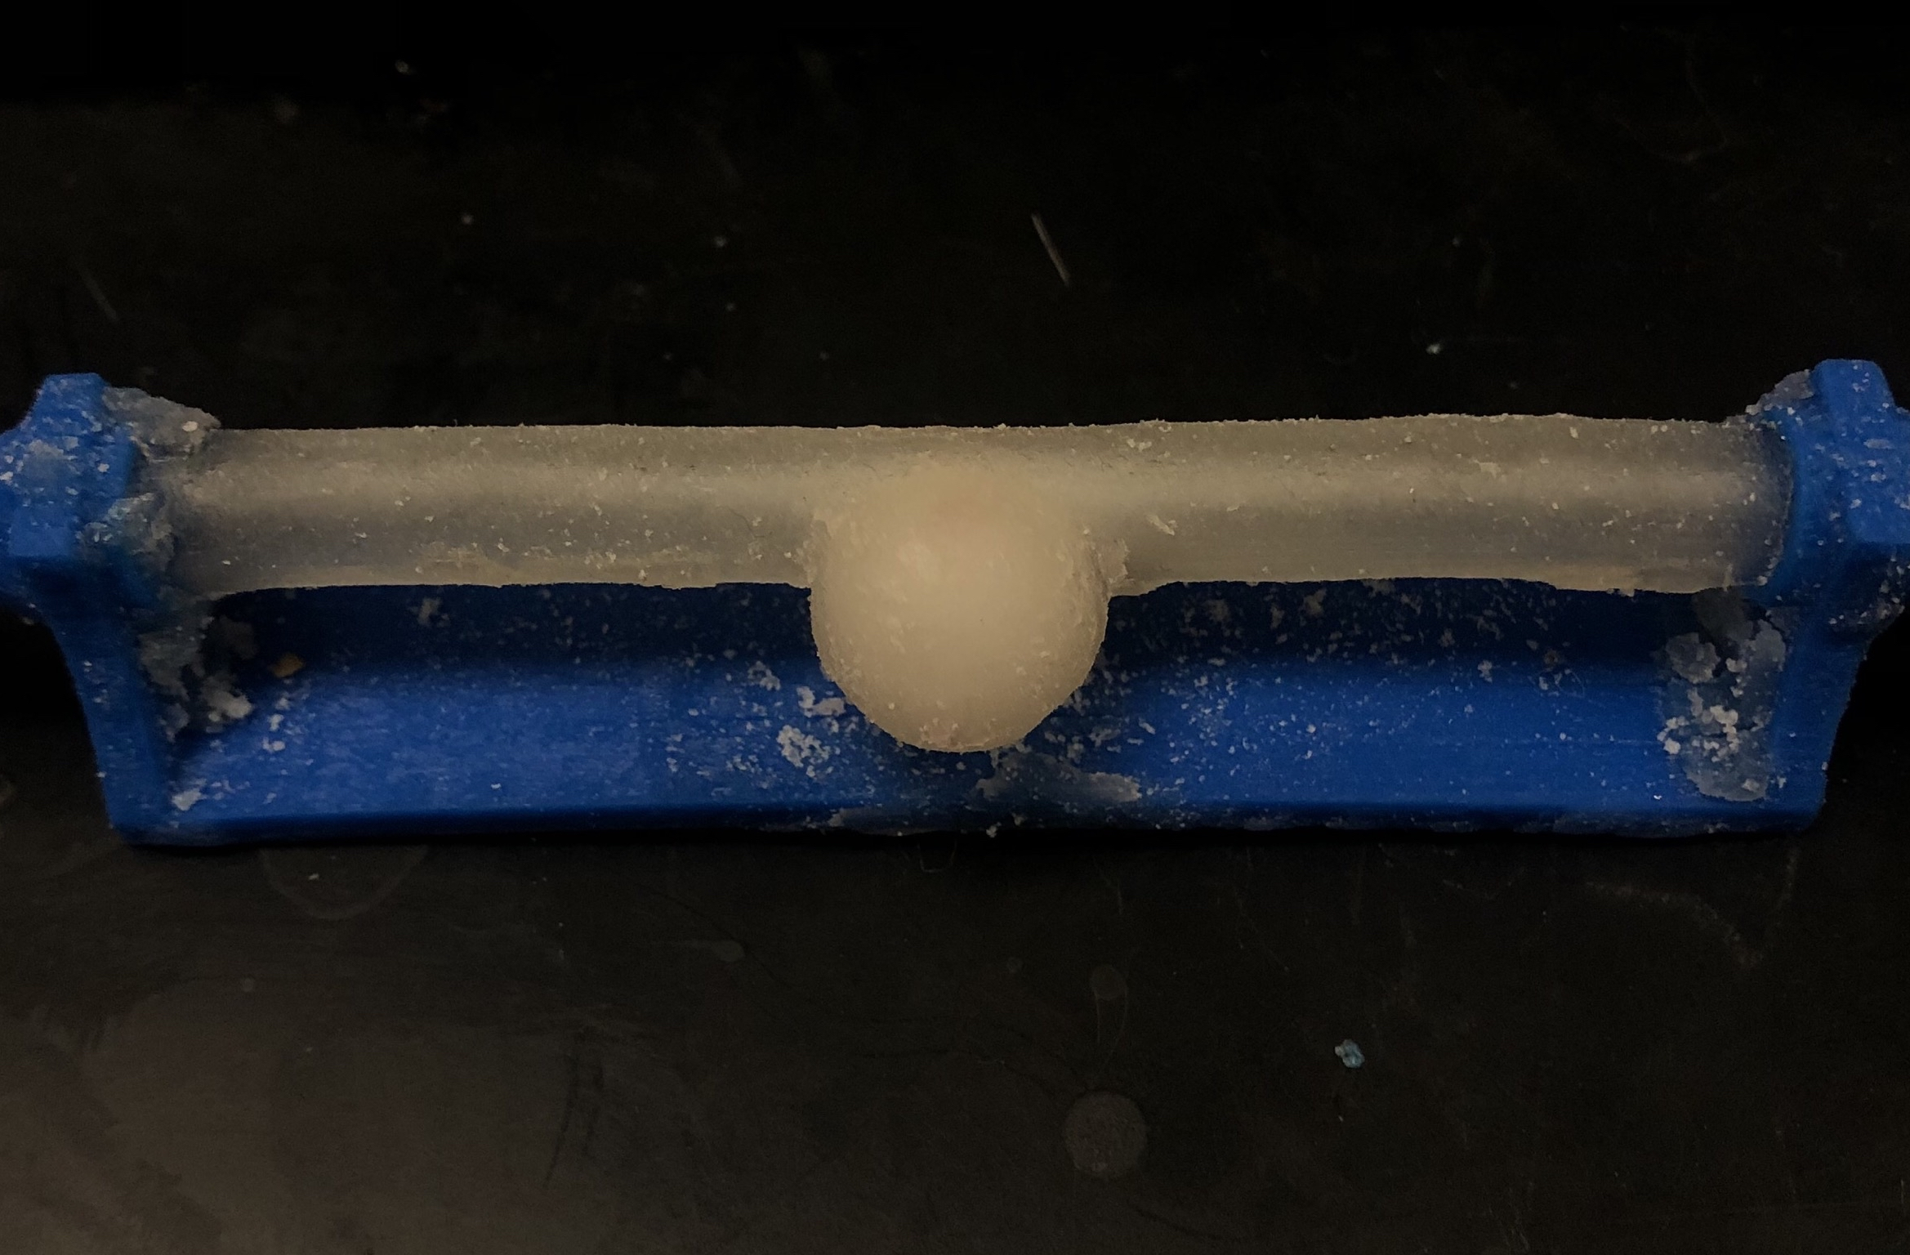
B-Roll
Figure 4. Top – Models with minimal to no cleaning, Bottom – Models that have been cleaned, Left to Right: CW, DAR, Sidewall

Slide 9
Specification Sheet - CRs
Table 2. Specification Sheet – Customer Requirements
CR # | Description | CR met? | Client Acceptable
CR 1 | Water Pump | Y | Y
CR 2 | Water Heater | Y | Y
CR 3 | Heat On/Off | Y | Y
CR 4 | System On/Off | Y | Y
CR 5 | Fast Cleaning | N | Y
CR 6 | Water Reservoir | Y | Y
CR 7 | Mesh Filtration | Y | Y
CR 8 | Multiple Cleaning Cycles before Filter Replacement | Y | Y
CR 9 | Universal Connectors | Y | Y
CR # | Description | CR met? | Client Acceptable
CR 10 | Adjustable Pressure | Y | Y
CR 11 | Compact Design | Y | Y
CR 12 | Pulsatile/Constant Flow Control | Y | Y
CR 13 | Automated Pressure Regulation/ Pressure Alert System | Y | Y
CR 14 | Temperature Measurement | Y | Y
CR 15 | Pressure Measurement | Y | Y
CR 16 | Clean Models | Y | Y
CR 17 | Unruptured Models | Y | Y
CR 18 | Undeformed Models | Y | Y

Slide 10
Specification Sheet - ERs
Table 3. Specification Sheet – Engineering Requirements
ER # | Description | Target | Units | Tolerance | Measured Value | ER Met? | Client Acceptable?
ER 1 | Working Water Temperature | 37 | °C | +13, -17 | 43 | Yes | Yes
ER 2 | Flow Rate | 4 | L/min | +/-2 | 3 | Yes | Yes
ER 3 | Working System Pressure | 150 | mmHg | +/- 75 | 200 | Yes | Yes
ER 4 | Reservoir Capacity | 1 | L | +/5 | 5 | Yes | Yes
ER 5 | Support Material Filter Capacity | 100 | g | -20, +100 | 130 | Yes | Yes
ER 6 | Heating Voltage | 115 | V (AC) | +/- 1 | 115 | Yes | Yes
ER 7 | Peristaltic Pump (PP) Voltage | 24 | V (DC) | +/- 1 | 24 | Yes | Yes
ER 8 | System Dimensions | 3x2x0.83 | ft | -/1 | 2.5x1.2x1.2 | Yes | Yes
ER 9 | Cleaning Time | 2 | hr | +/0.5, -/2.5 | 4 | No | Yes
ER # | Description | Target | Units | Tolerance | Measured Value | ER Met? | Client Acceptable?
ER 10 | Pressure Gauge Resolution | 1 | mmHg | +/- 0.5 | 1 | Yes | Yes
ER11 | Temperature Gauge Resolution | 1 | C | +/- 0.5 | 0.01 | Yes | Yes
ER12 | Filter Minimum Mesh Size | 1000 | µm | -/ 900 | 200 | Yes | Yes
ER13 | Signal Response Time | 1 | sec | +/- 0.5 | 1 | Yes | Yes
ER14 | Vessel Model Inlet Count | 3 | No units | 0 | 3 | Yes | Yes
ER15 | Proximal - Distal Pressure Differential | 0 | mmHg | +/ 15 | 12 | Yes | Yes
ER16 | Maximum Water Pressure | 200 | mmHg | +200 | 400 | Yes | Yes
ER17 | Maximum Water Temperature | 49 | C | +50 | 49 | Yes | Yes

Slide 11
QFD
*See Teams

Slide 12
Thank You

